Slide 1
Rule Engine concepts part 2
RETE
Notes:
This module introduces the RETE algorithm and how it applies to the previous modules concepts. There is also a quick lab showing how to see the some of these concepts in action in some rule examples.
Some brief discussion of LEAPS and how it differers is included.

Slide 2
RETE - history
Pronounced “ree-tee” or sometimes “reet”.
Is latin for “network”
Was developed by Dr. Charles Forgy, 1979, at CMU
  Under a Dept. Of Defense grant, hence public domain algorithm
OPS5 was first successful production rule system/language
  Was used by DEC to configure systems (large savings)
  ~10K rules
Notes:
As you can see, RETE is an “old” algorithm (most of them are !).
Historically, it was necessary to process the numbers of rules with the hardware available at the time, but of course is still relevant today. Rete is a battle proven algorithm.

Slide 3
RETE – key features
Exploits temporal redundancy
  Only changes to facts require work in each cycle
Exploits structural similarity
  When there are many rules, they share many patterns more often then not.
  “Node sharing” can provide performance boosts
Will use more memory for speed
Notes:
This summarizes some of the advantages that have been hinted at so far.
There is often a trade off to be made for speed and memory foot print, and RETE does this (as it has memories for pattern matches, index and so on – of course it will use more memory then the dumbest approach). But, for this trade off, you can often make it possible to solve a problem in linear time that would otherwise be impossible to solve (translation: its almost always worth it !).
Note that Drools also includes a LEAPS implementation which in some cases can reduce memory (or improve speed) as an alternative.

Slide 4
The RETE network
Two phases
  Compiling the network
    The network is an in memory “network” of nodes
  Runtime (applying facts to the network)
    The facts, at runtime, are kept in lists/memories for appropriate nodes
Notes:
Yes, RETE means network, but lots of people still say “RETE network”.
We will first tackle compiling of the network, and what it looks like conceptually.
Note that by “compiling” in this sense, we mean building the in memory structure of RETE, not compiling semantic code blocks which Drools allows.
Compiling is typically a one off cost (of course, you cache the built network, in Drools 3 it is serializable, in Drools 2.x it wasn't).

Slide 5
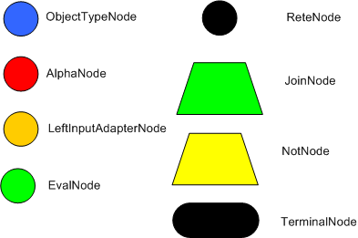
Network nodes (colour)
Notes:
When the RETE network is compiled, the patterns in the rules are decomposed into the in-memory rule network made up of the above nodes (node that facts will flow through at runtime). The idea is that the more rules you add, the more sharing of nodes there can be. Many rules make up one RETE network (or course you need at least one rule). An “efficient” RETE network will look like some kind of an inverted tree, with all the rules appearing down the bottom.
This slide shows some of the “nodes” (most) that the network is made of. In the original RETE network, some different terminology was used (1 input nodes, 2 input nodes etc), and it also was limited to equality tests at the lowest level, however, any modern RETE implementation would use something like these sorts of nodes (but it is implementation specific in parts, so assume we are talking about Drools – and ReteOO extensions to be precise).
ReteNode: this is the root node of the network (top of the tree, it all starts here, only one of these)
ObjectTypeNode: This sorts out classes, basically. So we have Driver, Accident classes, means 2 ObjectTypeNodes
AlphaNode: these are used where there are literal conditions. Eg: age < 42, name == “bob” (each one is an alpha node).
LeftInputAdapterNode: works off a single “object/fact” input, and turns it into a tuple (not really important for discussion, more of an implementation concern – but Jess uses one as well).
EvalNode: This node performs tests using previously “bound” variables (ie using semantic java code snippets) – is a boolean test (effectively decides if a fact should propagate down a network).
JoinNode: This node joins the results (outputs) of other nodes (eg 2 literal conditions) – it can also apply other constraints like predicates, bound variable constraints etc. (its all about joining data together)
NotNode: A special type of node for negating a pattern (ie the existence of a certain fact)
TerminalNode: This is the actual rule ! When facts make it this far, the rule is activated (put on the agenda)
Don't panic, more explanation follows...

Slide 6
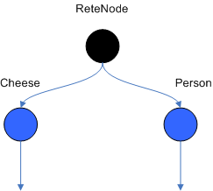
ObjectTypeNode
Sorts out facts based on Type (or “head” as it is historically known).
Notes:
ObjectTypeNodes are at the top level at the network (ie each fact hits them before anything else). In java terms, this basically is checking instanceof for a class (type). Of course interfaces/abstract/concrete classes are fine, as long as it looks like what the rule specifies as the type.
Historically this has been called the “head” of a pattern (ie in non-OO terms). This as in CLIPS, you had deftemplates, or ordered facts (like anonymous facts) which had the name at the “head”.
The purpose of this node is to reduce the amount of work the rest of the network has to do by shunting facts only down relevant parts of the network. For instance, at compile time we know that the Person object has an “age” field, but they don't have a “weight” field (cause it would be rude to ask for someones weight !). So there is no point in even trying to apply “weight” patterns to a Person instance (and in any case, it would fail !).

Slide 7
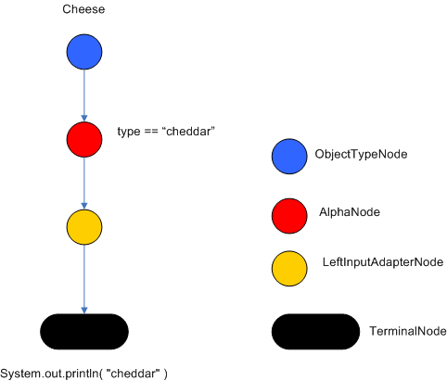
Worlds simplest RETE network
When Cheese(type==”cheddar”)
then System.out.println(“cheddar”);
Notes:
Lets back up a bit and examine a very very simple network for a very simple rule. (skip the “ReteNode” root node most of the time, its boring ;)
You can see we have an ObjectTypeNode which really checks if a fact is an instance of what the class is the rule is expecting. It actually uses Class.isInstance(Object) to work out if an incoming fact is satisfactory. The Class is the class as declared in the rule (which may be an interface, as long as the fact object is an instance of that class – note that ClassObjectType is an implementation for ReteOO in drools, and in future they will be other options for this sort of “head”/type checking).
Next is the alpha node of the [type == “cheddar”] literal constraint. Following this is the LeftInputAdapterNode which prepares the object for the final Terminal node (which contains the consequence of the rule, to print out something).
At runtime, a fact would enter at the top, assuming its a Cheese object, then its field constraint is checked, then the rule is activated. Then the agenda selects the rule, and fires it.
Thats it in a nutshell.

Slide 8
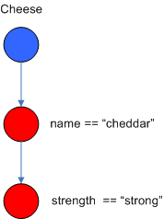
Alpha nodes
Cheese(name == “cheddar”, strength == “strong”)
Notes:
This should be fairly self explanatory.
The 2 literal constraints on the Cheese fact are 2 seperate alpha nodes. Remember alpha nodes are only on literals. If there was a constraint that used a previous bound field, it would not be an alpha node for that constraint (it would appear in a Join node).
Note also that Drools does an optimisation, so that when a fact hits a ObjectTypeNode, it can lookup an alpha node from a hashmap (keyed on the literal value) rather then propagating down.
Also note that the order in which the contraints are declared matters: put the more restrictive one first, as it means there is less work for it to do in propagating facts along the network.
Eg: if there was 1000 Strong cheeses, but only 2 types of cheddar, the above network would be optimal.

Slide 9
Summary
Now forget everything you just learnt ...
Notes:
A slightly humorous note to end on. But the fact is, you can use the rules engine without really needing to know RETE. You can certainly write rules without needing to know it. It can have performance implications for some people, and having a broad understanding can help you with performance tuning of course.

